Slide 1



Recommendation Engine
For CareerVillage.org
This Photo by Unknown author is licensed under CC BY.

Slide 2
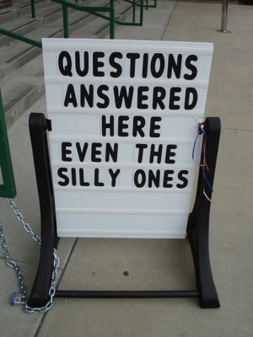
Problem: How to match students with questions to professionals with answers?
A real question in the dataset:
What is a maths teacher? what is a maths teacher useful? #college #professor #lecture
A real answer to that question <p>Hi!</p> <p>You are asking a very interesting question. I am giving you two sites that will give you some of an explanation that may answer your question.</p> <p>http://mathforum.org/dr.math/faq/faq.why.math.html</p> <p>http://www.mathworksheetscenter.com/mathtips/mathissoimportant.html</p> <p>Let me know if this helps</p>
This Photo by Unknown author is licensed under CC BY-SA-NC.

Slide 3


z
Challenges:
Data is noisy. No assumption of neat linear separability with language, even with the most common words excluded.
Far too many potential categories
Data is roughly formatted. Lots of extraneous punctuation, links, html tags, etc make feature extraction more difficult.
Data is plentiful. Accounting for limitations in computer memory and processing speed is a necessity if tens of thousands of records are to be cross-referenced in a reasonable amount of time.

Slide 4

Solution Strategy:
Unanswered questions are scored using cosine similarity against answered questions based on content and title
Users who answered highly scoring questions are collected and returned by algorithm

Slide 5
Solution consequences
Advantages
Disadvantages
Mostly useful recommendations
Predictable & controllable number of results returned
Fast and light on memory
Question focused: very likely to get good suggestion for users to answer a submitted question.
Users not firewalled by profession. Possible to recommend questions to a user who can't or shouldn't answer.
Not user-focused: recommendations depend on questions submitted. Some users might not have questions recommended for them

Slide 6
What does the solution look like?
Users recommended by algorithm
Sample Question (picked at random)
Title: What is the role and responsibilities of a project manager at a nonprofit organization? Body: I want to work for a nonprofit organization and I am trying to figure out what position would be best suited for me. #project-management #nonprofits #non-profit #non-profits #project-manager
Financial Services and Non-Profit Management | ▶▶ Program & Project Management ▶▶
Management Consulting | Associate - Management Consulting at PwC
Financial Services | Manager of Portfolio Management
E-learning | Aspiring adviser to STEM teens. Explains clearly, exhorts best practices. Raspberry Pi zealot.
Computer Games | Developer at FunWall inc.

